Slide 1
Battle of Neighborhoods
Capstone Project

Slide 2
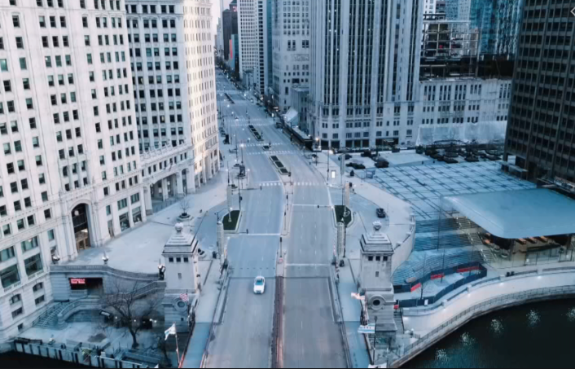
Business Problem
Residents of Toronto Downton neighborhoods started looking for better places to live, as global COVID pandemic impacted busy financial center.
In order to help with new neighborhood search, we developed a model based on Toronto geolocation and Foursquare venues. The model contains venues which are highly attractable during pandemic, such as parks, dog playgrounds, outdoor venues, and medical centers.

Slide 3

Data source
Toronto neighborhoods listing with geolocations from Wikipedia.
Listing of Toronto amenities and facilities from Foursquare API.
We will focus on amenities which allow social distancing, considering specific of current COVID pandemic and focus of this research.

Slide 4
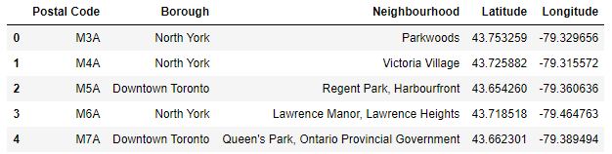
Methodology
Set up Toronto neighborhood data frame with geolocations.
Clean the data, from blanked and repeating entries.

Slide 5
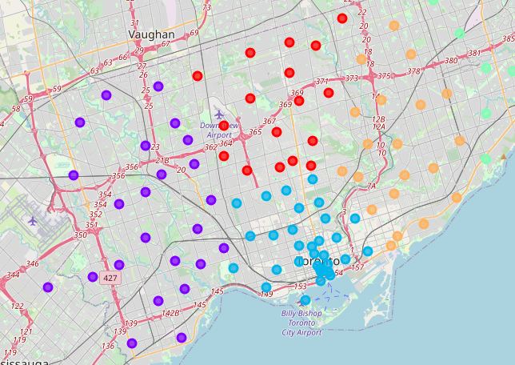
Methodology
Analyze neighborhood clusters with folium maps

Slide 6
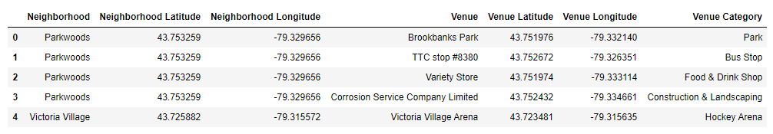
Methodology
Create Toronto venues data frame from Foursquare, and merge it with Toronto geolocation neighborhoods.

Slide 7
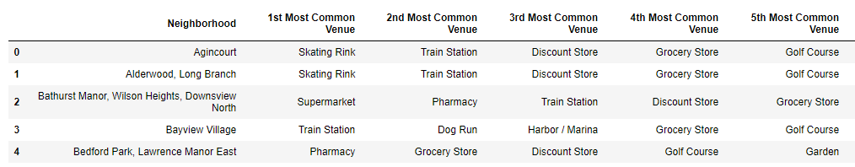
Methodology
Drop venues, which are not COVID friendly, such as restaurants and entertainment centers. Keep only parks, medical centers and grocery stores.

Slide 8
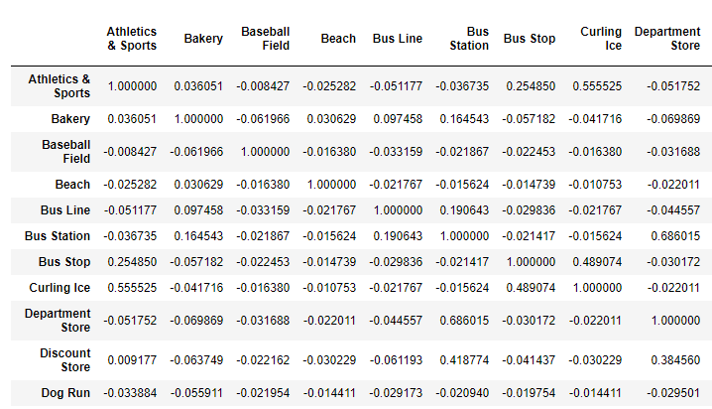
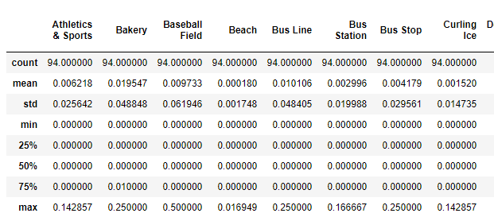
Methodology
Perform correlation and descriptive statistics analysis to learn any data patterns.

Slide 9
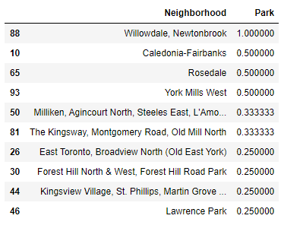
Methodology
Finalize model to pull data for specific customer needs and preferences based on mean frequency. For example, if someone looking for a neighborhood with park, here is a top selection.

Slide 10
results
As a result of this project, we build a model of Toronto neighborhoods with COVID friendly venues.
The model is based on the Toronto geolocation data, and Foursquare venues.
The model allows find suitable neighborhood based on specific preferences, such as park hospitals, dog playgrounds, grocery stores and proximity to public transit.

Slide 11
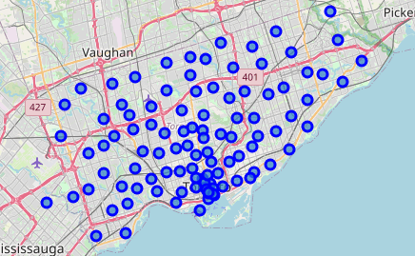
discussion
I observed that there is no positive / negative correlations between current data set.
Another thing is concentration of 103 neighborhoods. We can clearly see that neighborhoods are heavily concentrated around Toronto’s downtown core, and less spread toward to city borders.

Slide 12
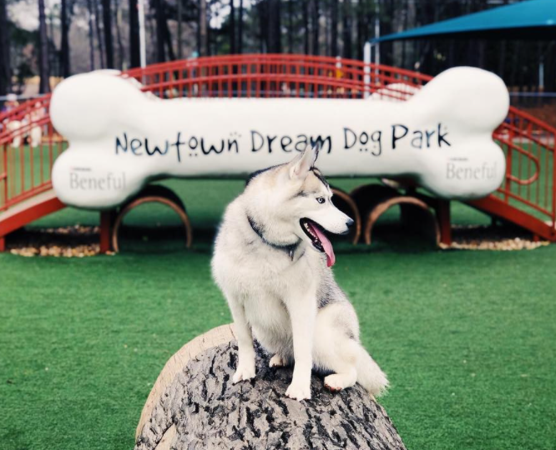
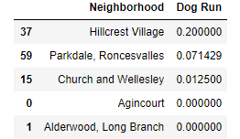
conclusion
Residents of Toronto Downton neighborhoods started looking for better places to live, as global COVID pandemic impacted busy financial center.
In order to help with new neighborhood search, we developed a model based on Toronto geolocation and Foursquare venues. The model contains venues which are highly attractable during pandemic, such as parks, dog playgrounds, outdoor venues, and medical centers.
Models allows to factor specific individual needs of each person seeking to relocate to a new neighborhood and help them find optimal living solution.
For example, a dog owner currently living in Toronto downtown would be interested in Hillcrest Village neighborhood with the highest mean playground rating among 103 Toronto neighborhoods.

